Slide 1
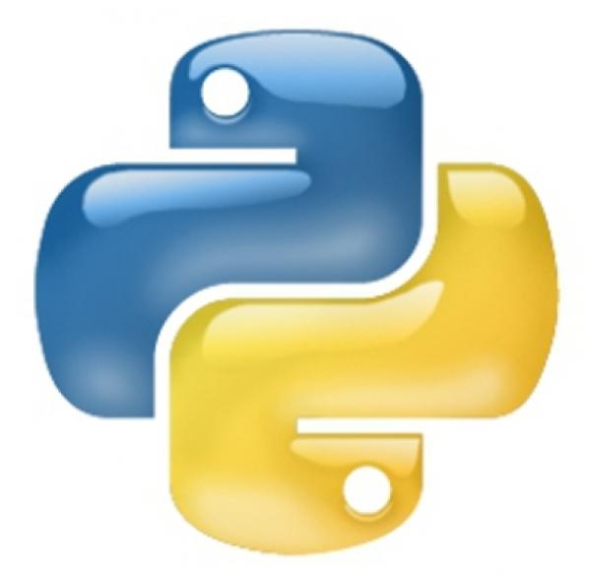
Why Python Should Be Your First Programming Language
View Mastering Python course details at http://www.edureka.co/python
For Queries:
Post on Twitter @edurekaIN: #askEdureka
Post on Facebook /edurekaIN
For more details please contact us:
US : 1800 275 9730 (toll free)
INDIA : +91 88808 62004
Email Us : webinars@edureka.co

Slide 2
Objectives
At the end of this module, you will be able to understand:
Python’s Short Learning Curve
Duck Type Programming Language
Python Features
Python For Analytics
Big Brands Using Python
Python Job Trend

Slide 3
Short Learning Curve

Slide 4
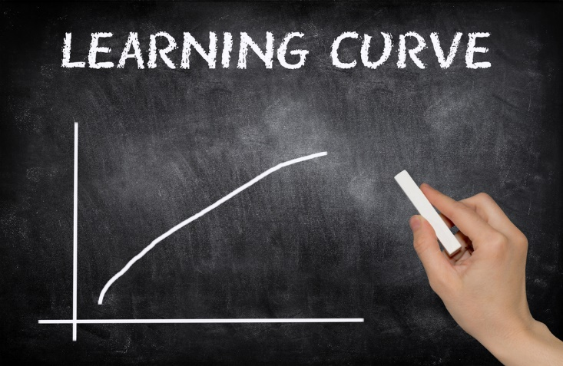

Easy to Learn
Python is a great language for the beginner programmers since it is easy-to-learn and easy-to-maintain.
Very Readable

Slide 5
Python Hello World
Here’s an example of how easy and readable Python is.
Hello World in C++
#include stdout
int main()
{
std::cout << "Hello, world!\n";
}
Hello world in Java
class HelloWorldApp
{
public static void main(String[] args)
{
System.out.println("Hello World!");
}
}

Slide 6
Python Hello World
Here’s an example of how easy and readable Python is.
Hello World in C++
#include stdout
int main()
{
std::cout << "Hello, world!\n";
}
Hello world in Java
class HelloWorldApp
{
public static void main(String[] args)
{
System.out.println("Hello World!");
}
}
Hello World in Python
print("Hello, world!")

Slide 7

No Curly Braces
Focus on learning programming concepts and paradigms rather than wasting time in understanding syntax
You don’t have to worry about curly braces in Python
{ }

Slide 8
Easy Setup

Slide 9

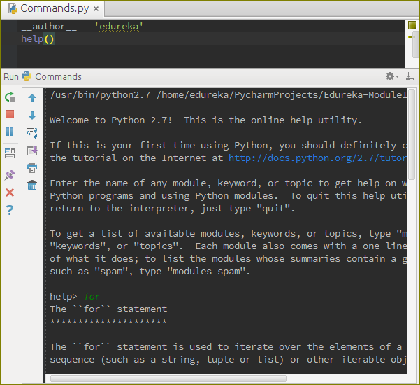
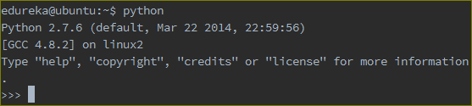
Easy Setup
Very Minimal Setup
You don't need to learn a build system, IDE, special text editor, or anything else to start using python - a command prompt, the interactive editor, and a simple text editor, are all you need

Slide 10
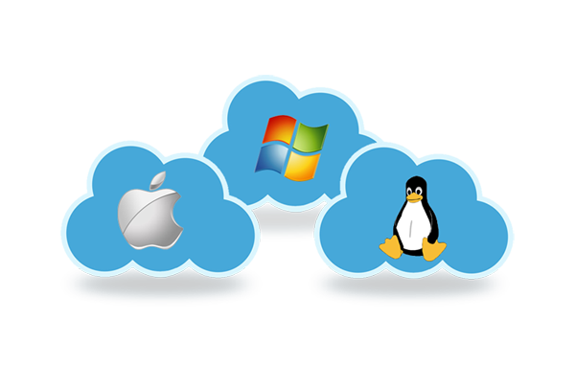
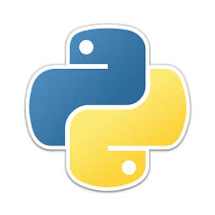
Portability of Python
Python’s biggest strength is that the bulk of it’s library is portable.
Supports GUI Programming and can be used to create Applications portable on Mac, Windows and Unix X-Windows system.

Slide 11
Python Features

Slide 12



Language Features
YOU’RE FLYING!
HOW??
PYTHON

Slide 13
Language Features
Interpreted
Object-oriented
Interactive
Highly Readable
Dynamic
Functional
YOU’RE FLYING!
HOW??
PYTHON

Slide 14
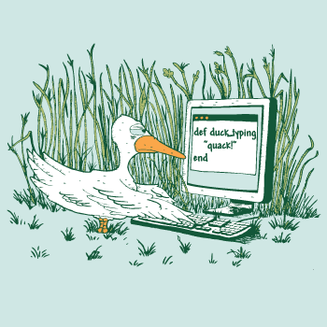
Duck Type Programming Language
In duck typing, a programmer is only concerned with ensuring that objects behave as demanded of them in a given context, rather than ensuring that they are of a specific type.
Python passes Duck test.
Reference: https://coronalabs.com

Slide 15
With libraries like PyDoop and SciPy, it’s a dream come true for Big Data Analytics

Slide 16

PyDoop – Hadoop with Python
Python can be used to write Hadoop MapReduce programs and applications to access HDFS API for Hadoop with PyDoop package
PyDoop package provides a Python API for Hadoop MapReduce and HDFS
PyDoop has several advantages over Hadoop’s built-in solutions for Python programming, i.e., Hadoop Streaming and Jython
One of the biggest advantage of PyDoop is it’s HDFS API. This allows you to connect to an HDFS installation, read and write files, and get information on files, directories and global file system properties
The MapReduce API of PyDoop allows you to solve many complex problems with minimal programming efforts. Advance MapReduce concepts such as ‘Counters’ and ‘Record Readers’ can be implemented in Python using PyDoop

Slide 17
Demo: Python NLTK on Hadoop
Leveraging Analytical power of Python on Big Data Set. (MR + NLTK)
Perform stop word removal using Map Reduce.

Slide 18
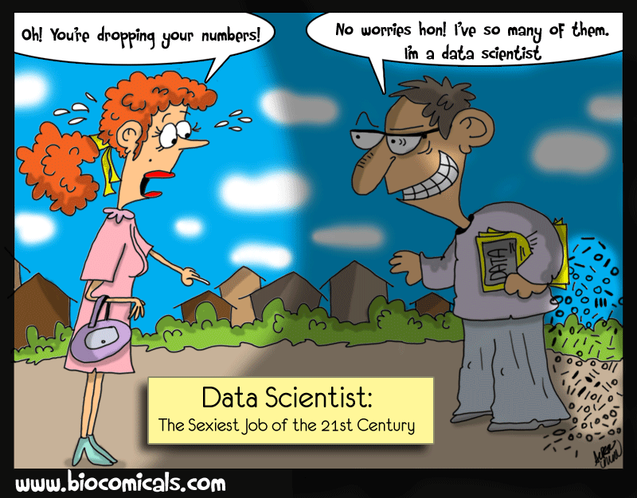
Python and Data Science
The day-to-day tasks of a data scientist involves many interrelated but different activities such as accessing and manipulating data, computing statistics and , creating visual reports on that data, building predictive and explanatory models, evaluating these models on additional data, integrating models into production systems, etc.
Python is an excellent choice for Data Scientist to do his day-to-day activities as it provides libraries to do all these things
Python has a diverse range of open source libraries for just about everything that a Data Scientist does in his day-to-day work
Python and most of its libraries are both open source and free

Slide 19
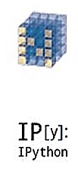
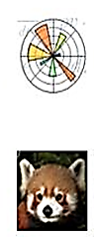

SciPy.org
SciPy (pronounced “Sigh Pie”) is a Python-based ecosystem of open-source software for mathematics, science, and engineering.
NumPy
Base N-dimensional
array package
SciPy library
Base N-dimensional
array package
Matplotlib
Comprehensive 2D Plotting
IPython
Enhanced Interactive
Console
pandas
Data structures and analysis
Sympy
Symbolic mathematics

Slide 20
Python’s Popularity

Slide 21




Big Brands Using Python
YouTube is originally written in Python and mysql.
Yahoo acquired Four11, whose address and mapping lookup services were implemented in Python.
Yahoo Maps uses Python.
Dropbox web-based file hosting service is implemented using Python
Both the Dropbox server (running in the cloud) and desktop client software are primarily written in Python.
Many components of the Google spider and search engine are written in Python.
Reference: http://en.wikipedia.org/wiki/List_of_Python_software

Slide 22




Big Brands Using Python
Zope Corporation has developed Blue Bream (a powerful Web application server) using Python that's available as free software.
- http://bluebream.zope.org/
Shopzilla is a family of comparison shopping sites.
Shopzilla uses Python for configuration management and deployment, automated testing and internal tool development.
Ultraseek Server, a commercial search engine product, is implemented as an elaborate multi-threaded Python program.
The program contains over 11,000 lines of Python code, and the user interface is implemented with over 17,000 lines of Python-scripted HTML templates.
YUM, a package management utility for RPM-compatible Linux operating systems is written in Python.
Reference: http://en.wikipedia.org/wiki/List_of_Python_software

Slide 23
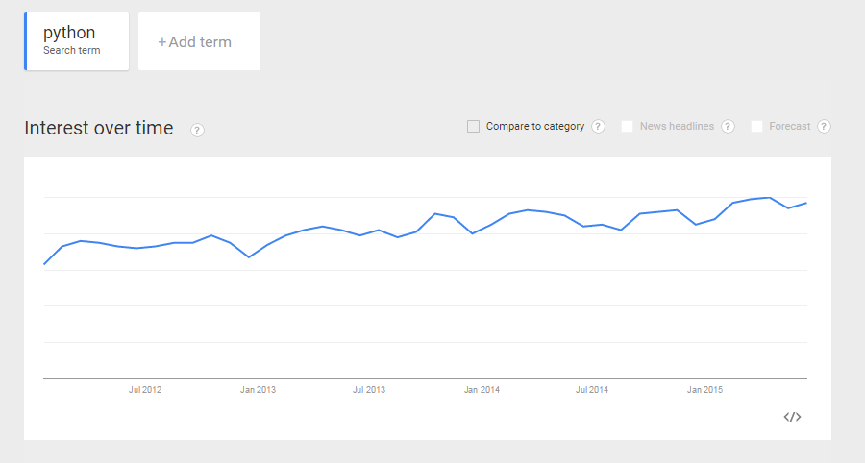
Growing Interest in Python

Slide 24
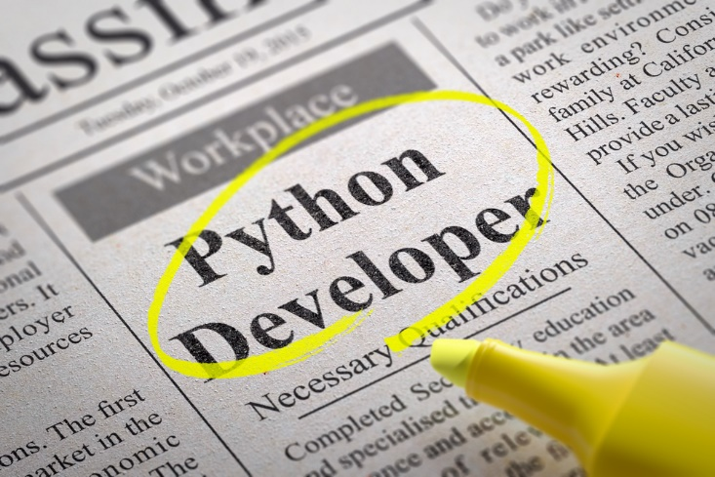
Hot Job Trend

Slide 25
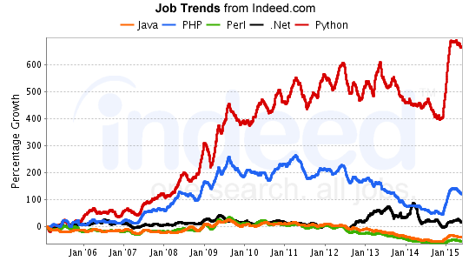
Python Job Trend Comparison

